Slide 1
Autonomous Carrier Assistant
Amine Chahli
Richard Garces
Muhammad Khan
Hunter Busa
CDR Report

Slide 2
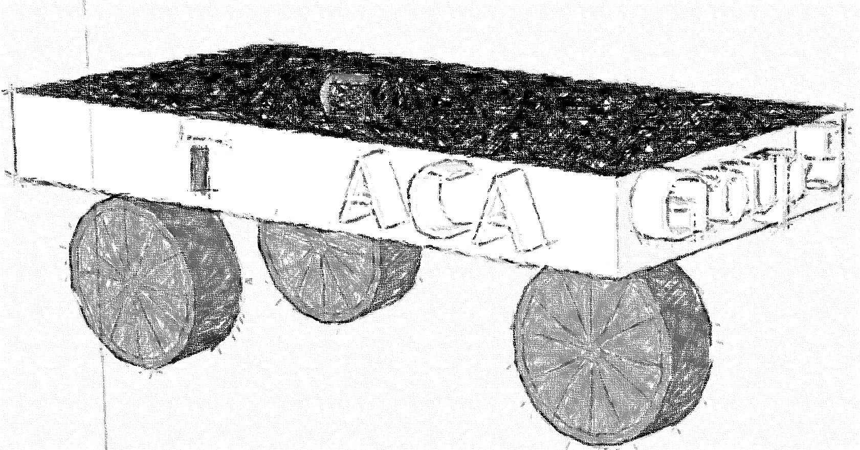
Content List
Project Objective / Goal
Requirements / Specification
Components
PCB
Budget / Finance
Work Distribution

Slide 3
Goals and Objectives
Hunter Busa
Our main goal is to have the Autonomous Carrier Assistant follow the user autonomously.
The ACA should provide convenience for the user by carrying their items.
The ACA will be able to autonomously lead the user to preset locations.
An easy to use mobile app will be implemented to control the ACA by the user.

Slide 4
Specification/Requirements
Richard Garces
Specification | Requirement | Target
Collision detection | Detect objects and redirect or stop | 3-8ft
Follow consumer | Follow consumer at a consistent distance | 2-5 ft
Lead consumer | Will plan a route based on a map system and lead the consumer to their target destination at a distance | 2-5 ft
Battery Power | Provide enough battery life to complete consumers needs | Up to 4 hrs
Mobile App | Connect to a mobile device quickly | 20-30 secs

Slide 5
Components

Slide 6
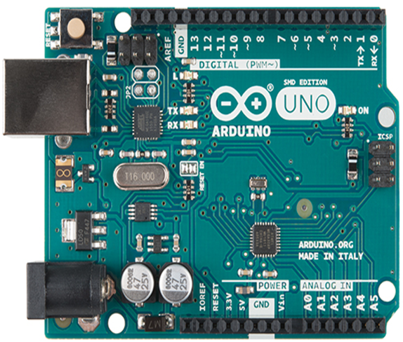
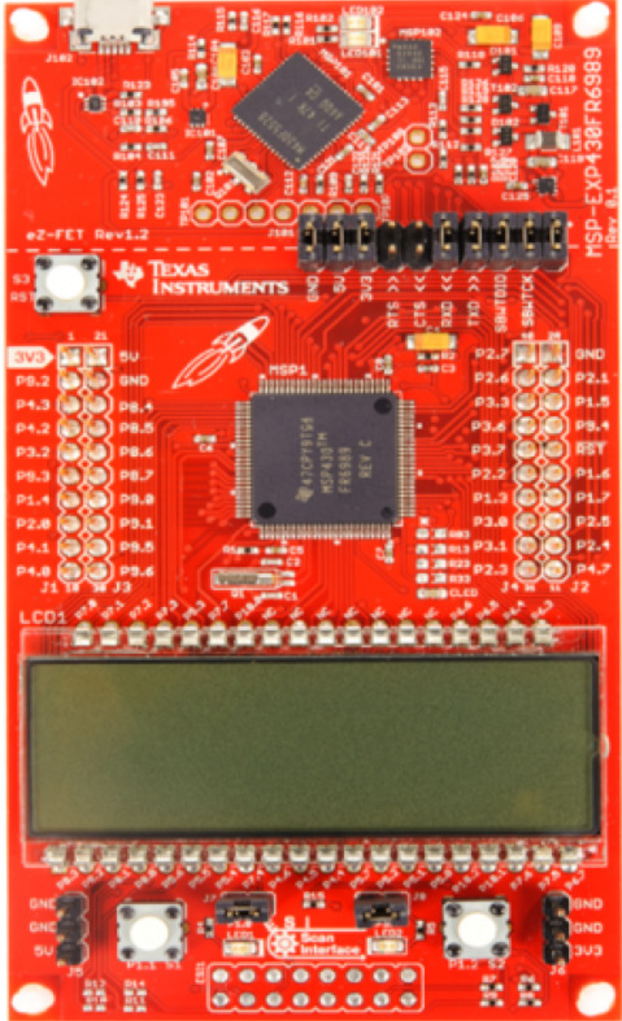
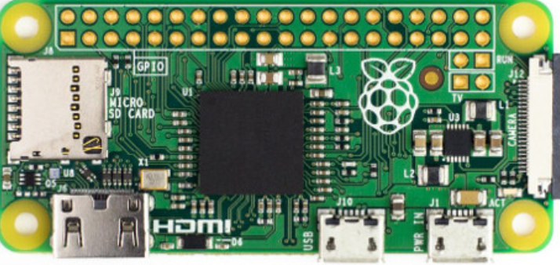
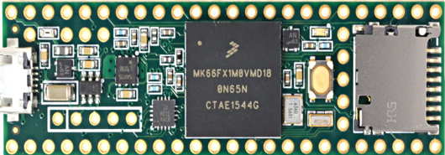
Microcontroller Options
Richard Garces

Slide 7
Microcontroller Comparison
Richard Garces
Development board | Arduino uno Rev 3 | Raspberry Pi Zero | MSP 430RF6989 | Teensy 3.6
Microcontroller | Atmega328P | BCM2835 | 430RF6989 | MK66FX1mo
Cost | $2.08 | $5.00 | $3.30 | $17.65
Architecture | 8-bit | 32-bit | 16-bit | 32-bit
Clock | 20Mhz | 1Ghz | 16Mhz | 180Mhz
Operating Voltage | 1.8-5.5V | 1.8-3.3V | 1.8-3.6V | 1.71-3.6V
Power Consumption | 200uA/Mhz | 100mA | 100uA/Mhz | 90mA

Slide 8
MCU Selection Arduino Uno Rev 3
Richard Garces
Popularity – There is a lot of information available
Ease of Use – User friendly IDE does not require high level knowledge
Community – Lots of hobbyist use Arduino
Resources – YouTube, online forums, Articles, Libraries

Slide 9
Coding with Arduino
Richard Garces
The IDE is Written in JAVA
The actual coding is done in C++
Due the popularity and resources many codes exist
Use existing codes and Tweak them to reach our requirement and specifications

Slide 10
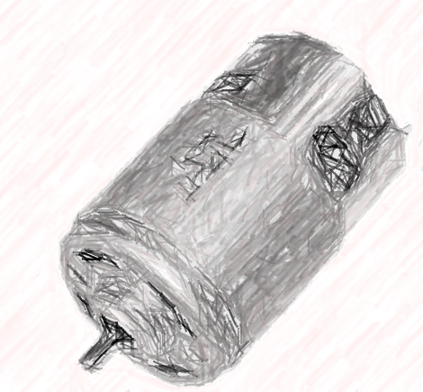
DC Motor / Driver
Muhammad Khan
Specifications:
Motor Diameter: 1.75“
Motor Length: 3.5“
Shaft Length: 0.375“
Shaft Diameter: 0.16“
Solderable Terminal: 0.189"
Running motor under No Load:
Voltage | Current | Speed
24 V | 270 mA | 7000 rpm
12 V | 240 mA | 3500 rpm
6 V | 210 mA | 1380 rpm

Slide 11
Motor Driver L298N H-Bridge
Muhammad Khan
Specification
Dual H Bridge Motor Driver
L298N motor driver IC
Drives up to 2 bidirectional DC motors
Integrated 5V power regulator
5V – 35V drive voltage
2A max drive current
Truth Table

Slide 12
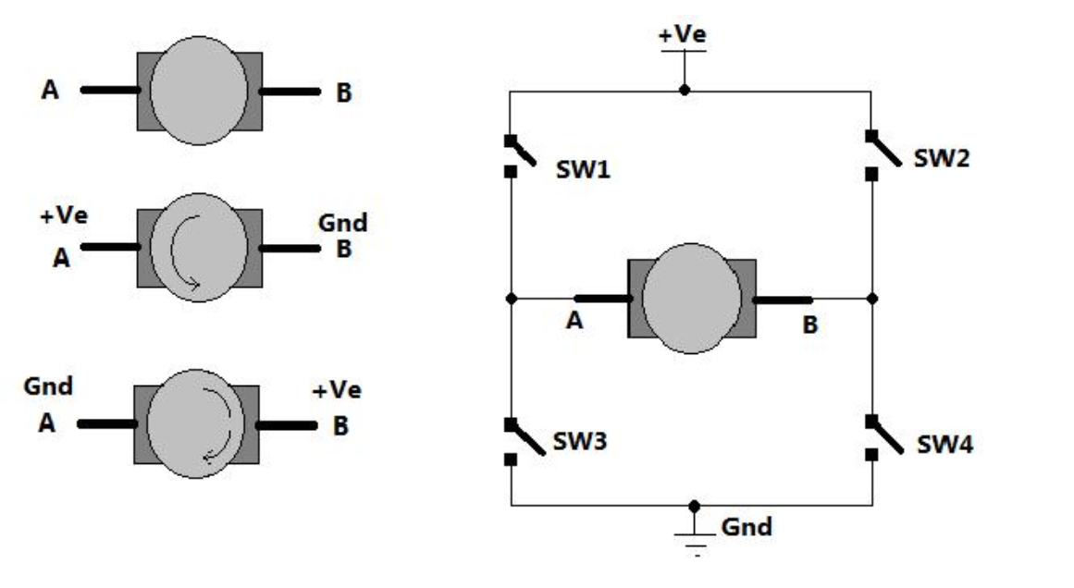
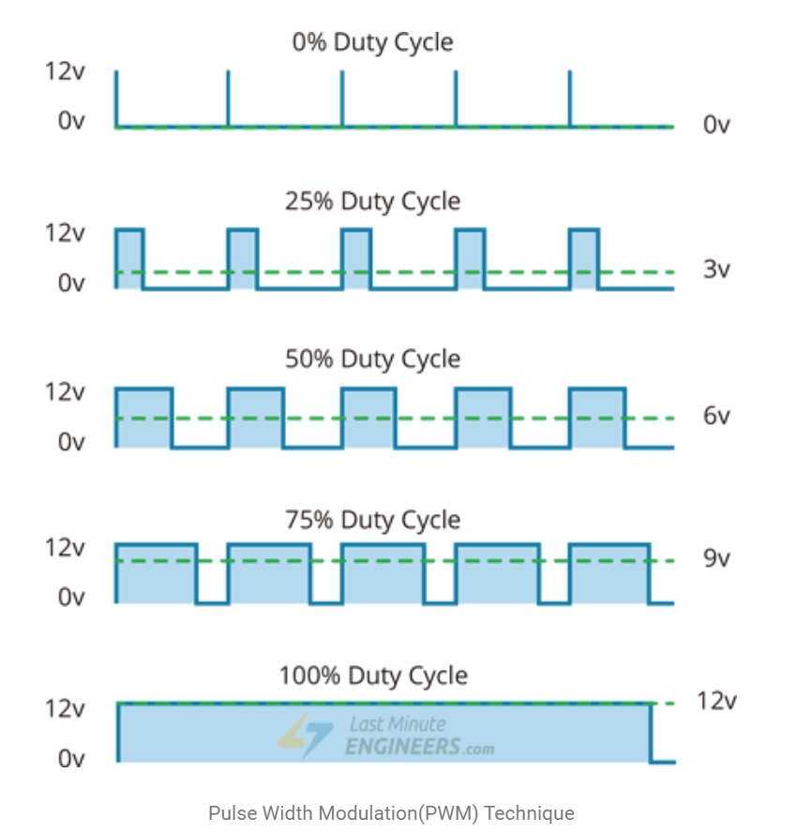
H- Bridge PMW
Muhammad Khan
Dc motor Control with L298N
PWM – For controlling speed
H-Bridge – For controlling rotation direction

Slide 13
Muhammad Khan
The spinning direction of a motor can be controlled by applying either a logic HIGH(5 Volts) or logic LOW(Ground) to these inputs. The table illustrates how this is done.
Input1 | Input2 | Spinning Direction
Low(0) | Low(0) | Motor OFF
High(1) | Low(0) | Forward
Low(0) | High(1) | Backward
High(1) | High(1) | Motor OFF

Slide 14
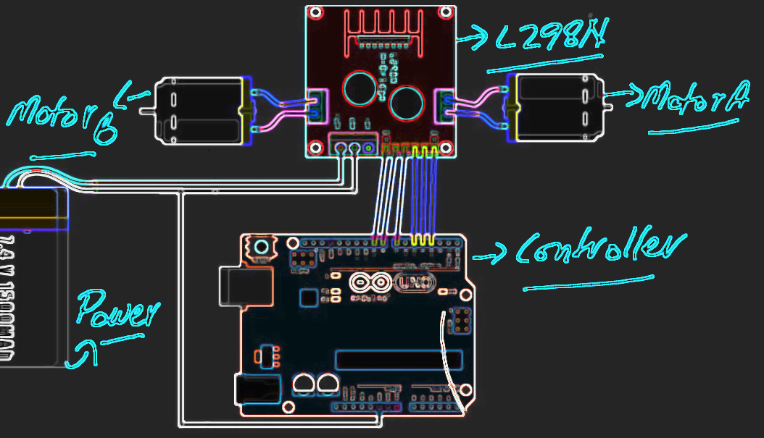
Motor Driver Setup
Muhammad Khan

Slide 15
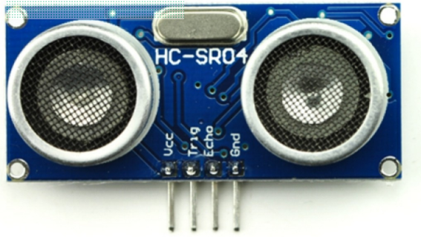
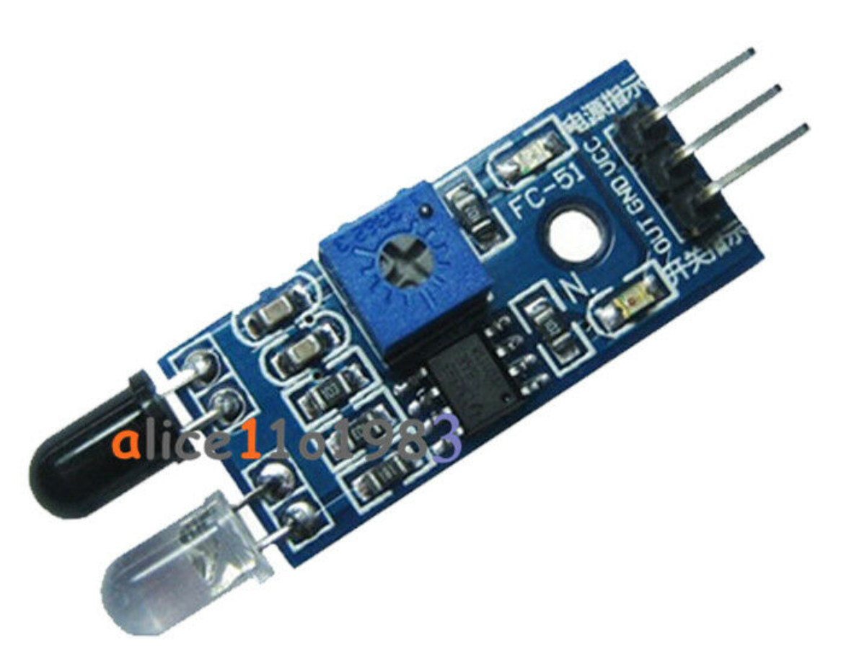
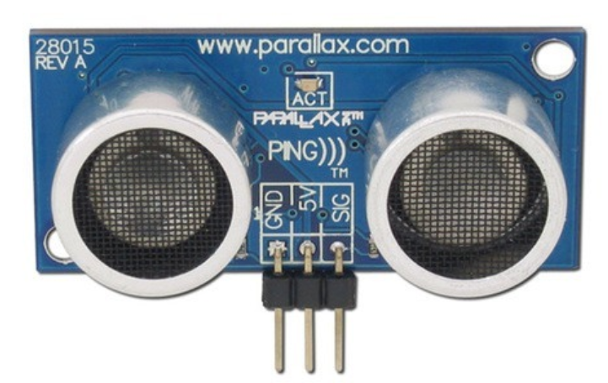
Sensor Comparison
Muhammad Khan
 | Ultrasonic | Infrared | Ping
Range | 2-400cm | 2-40 cm | 3-300cm
Cost | $1.50 | $8.95 | $29.99
Accuracy | Good | Fair | Excellent
Frequancy | 40 kHz | 353 THz | 40 kHz
Beam Pattern | Conical | Narrow Line | Narrow Angle

Slide 16
HC-SR04 Ultrasonic Sensor
Muhammad Khan
Specification
Working Voltage: DC 5V
Working Current: 15mA
Working Frequency: 40Hz
Max Range: 400cm
Min Range: 2cm
Measuring Angle: 15 degree
Trigger Input Signal: 10µS TTL pulse
Echo Output Signal Input TTL lever signal and the range in proportion
Dimension 45 * 20 * 15mm
Advantages
High sensitivity
Easy to detect external or deep object
Greater Accuracy
Low Power Consumption
Low Cost

Slide 17
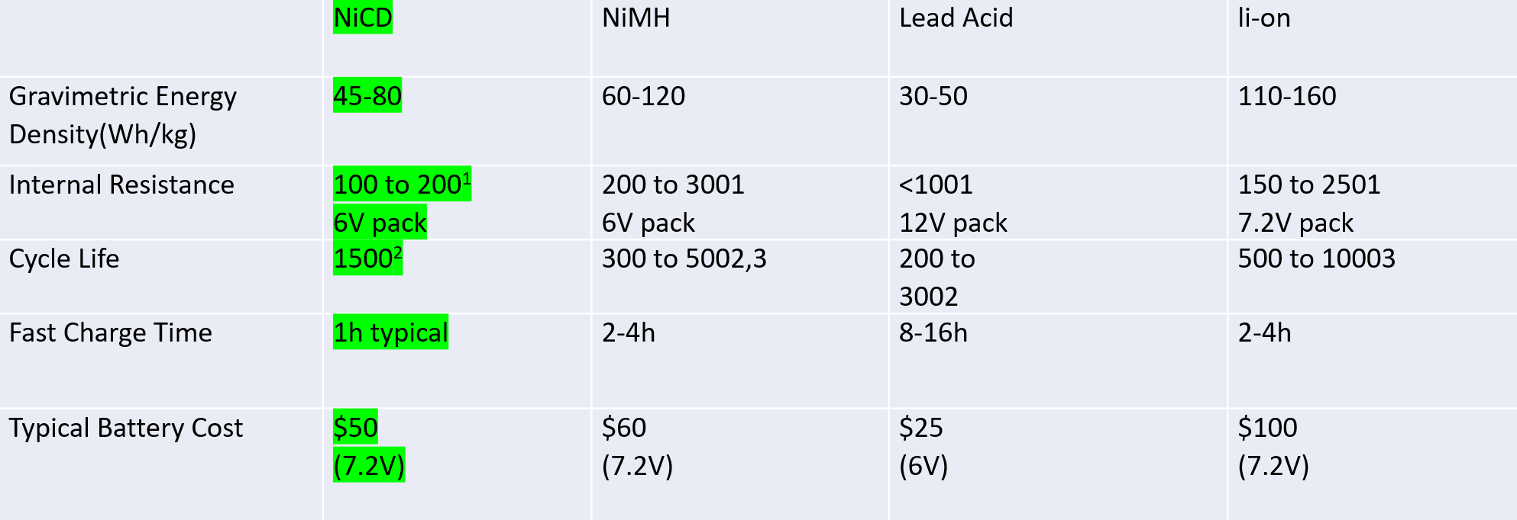
Battery
Amine Chahli
Fast and simple charge
provides over 1000 charge/discharge cycles.
Long shelf life – in any state-of-charge.
the NiCd is the lowest cost battery in terms of cost per cycle.
Available in a wide range of sizes and performance options — most NiCd cells are cylindrical.

Slide 18
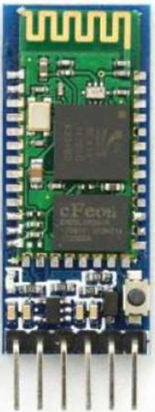
Bluetooth
Hunter Busa
This is the HC-05 Bluetooth module for the Arduino.
The purpose of this is to connect the Arduino to the mobile app and send information through it.
Plenty of online resources and tutorials that use this exact Bluetooth module.
Operating Voltage of 4 – 6 Volts with a current of 30mA.
It uses Frequency-Hopping Spread spectrum (FHSS) to send its signals.
It has a range of up to 100m.
Master/Slave mode.
This is important for sending information from the microcontroller to the phone or vice versa.
Cost effictive

Slide 19
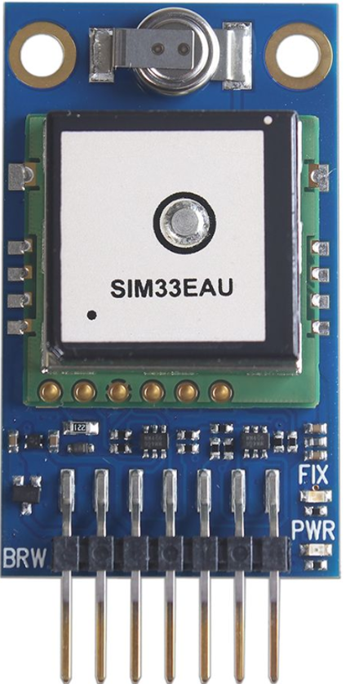
GPS Module
Hunter Busa
Specs
Ready for use with 3.3 V – 5 V microcontrollers with 60mA max but typically operates with 45mA.
Power and satellite fix LEDs.
Navigation update rate: up to 10 Hz.
33 tracking and 99 acquisition channels with jamming elimination.
Indoor and outdoor multi-path detection and compensation.
Speed accuracy: 0.1 meter/second.
This is the SIM33EAU GPS Module and can be integrated with multiple boards including the Arduino.
With this module the ACA will be able to read its position on earth.
Highly accurate module that offers location fix, speed, heading, altitude, and atomic date and time

Slide 20
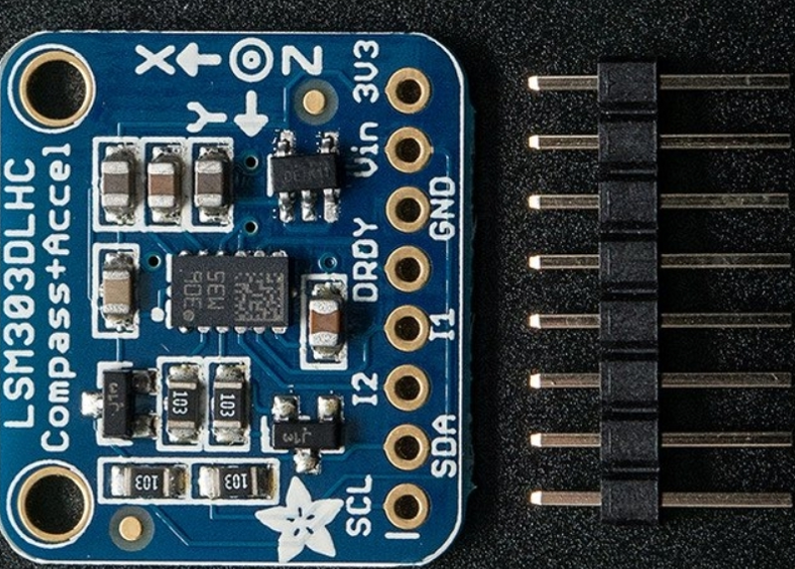
Magnetometer Compass Board
Hunter Busa
Specs
Ready to use with 3V or 5V microcontrollers.
Selectable power mode/resolution for accelerometer and magnetometer.
This board also has an accelerometer to detect which direct is down towards earth but we will not need to use that feature for the ACA.
16-bit data output.
3 magnetic field channels and 3 acceleration channels.
Programmable interrupt generators for freefall, motion detection and magnetic field detection.
This is the Triple-axis LSM303 Magnetometer Compass Board that can be integrated with the Arduino.
Combined with the GPS Module this is how the ACA will become autonomous and follow/lead the user.
A very easy to use sensor that uses I2C to communicate.
It’s purpose is to sense magnetic north so we can orient the ACA’s position.

Slide 21
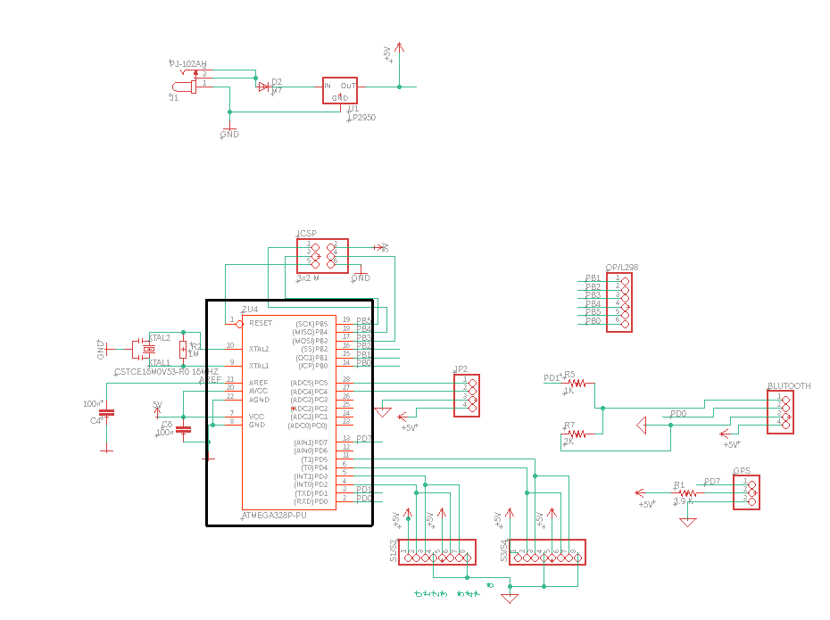
System schematic
Amine Chahli
The is the core of the hardware platfATmega328P-PU orm. Here the ATmega328P-PU is basically pined out to headers, has its ICSP port exposed, a 16MHz crystal, and the power bypass capacitors.
ATmega328P-PU

Slide 22
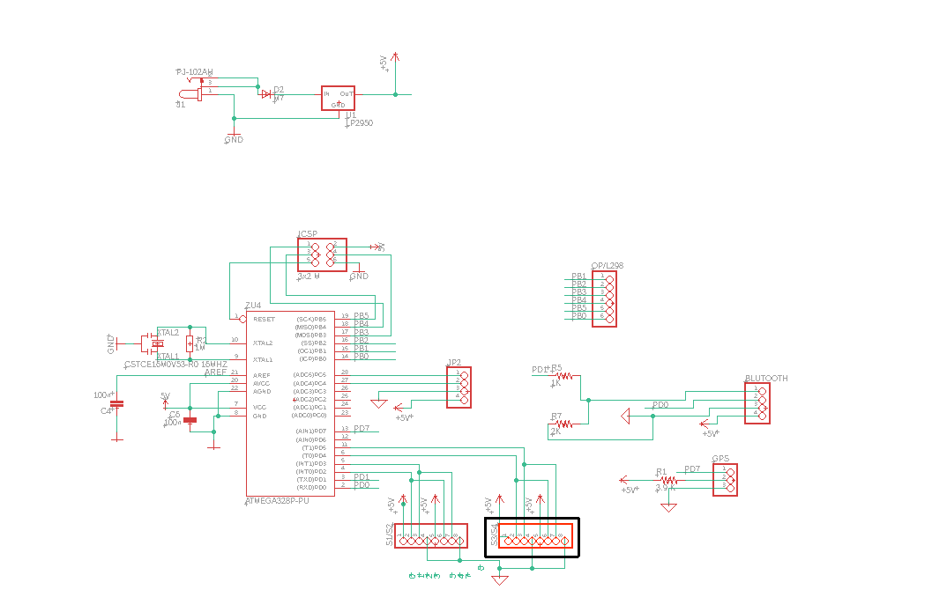
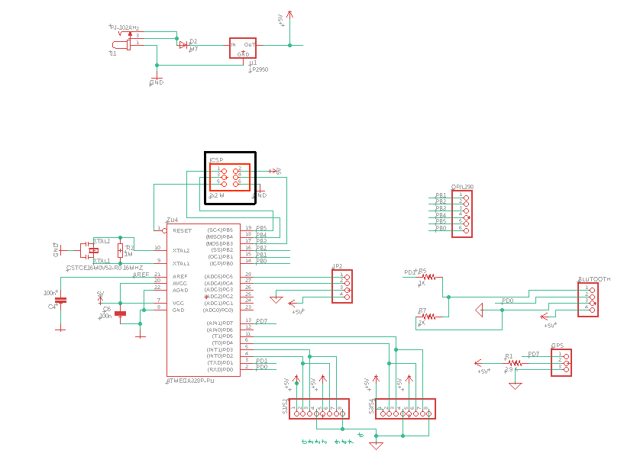
Amine Chahli
All this part of the circuit does is take the differential signaling from the USB connection and convert it to a serial signal that the UART on the ATmega328P.
4 Bluetooth output
Source voltage 5V
Digital pins

Slide 23
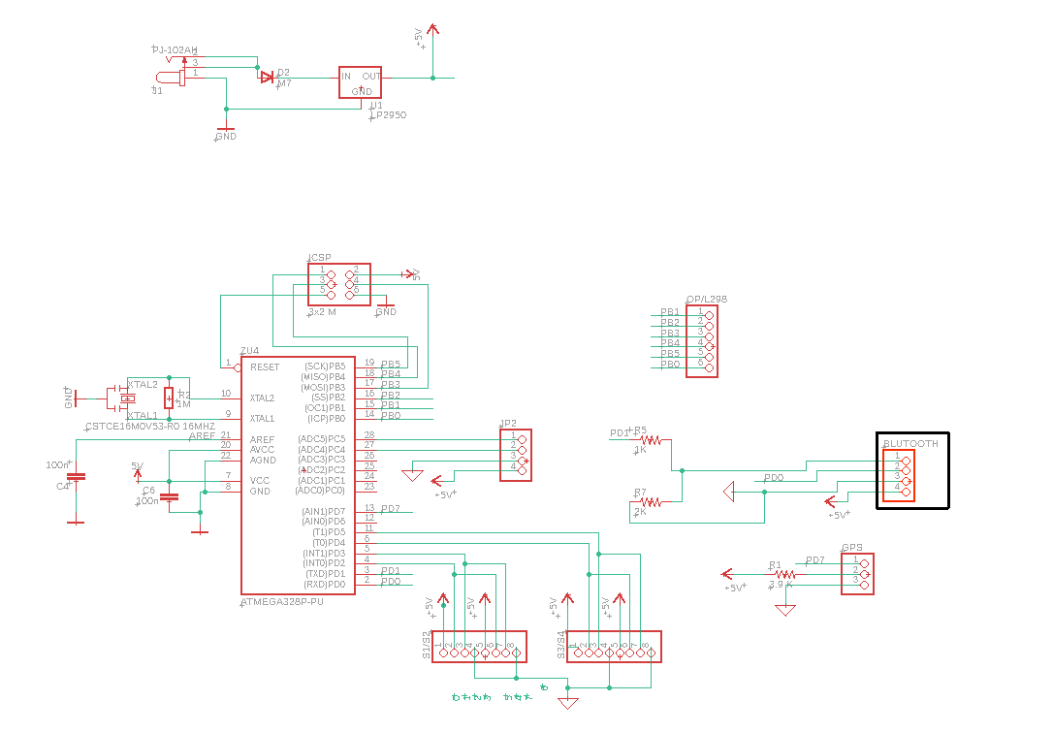
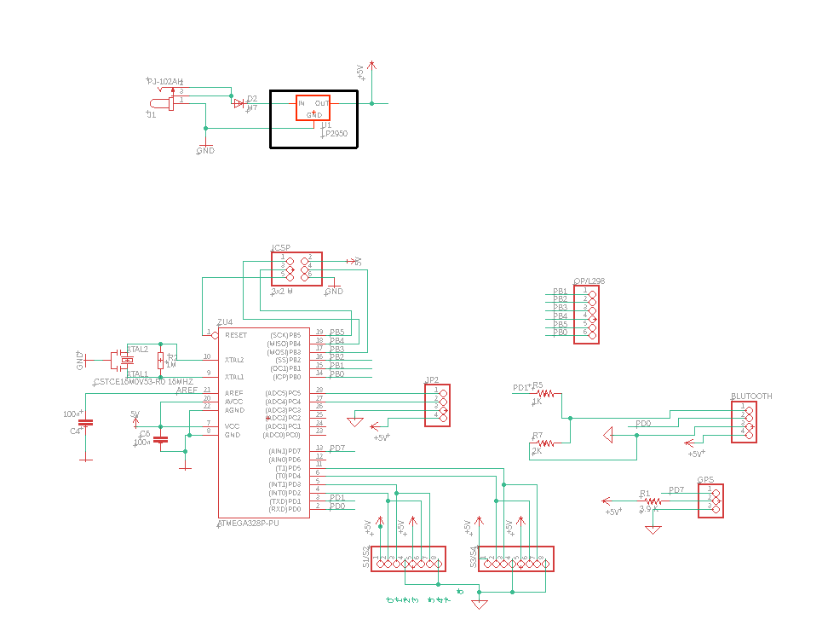
Amine Chahli
HC-05 Bluetooth
Power Supply Circuit
The 5V regulator is the LP2950 and the Vin of this regulator is connected via DC jack input through the diode, This diode provides reverse-polarity protection.
The input at the DC jack is 12 V and output after the LP2950 is 5V
Bluetooth module pins VCC is connected to 5V
Bluetooth module pin TXD is connected PD0
Bluetooth module pin RXD is connected to PD1

Slide 24
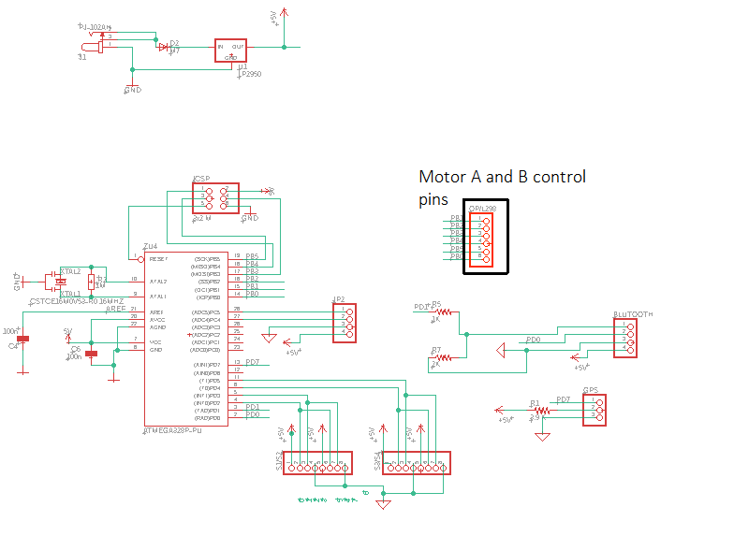
Amine Chahli
Motor Controller
the Input 5 and Input 6 pins are used for controlling the rotation direction of the motor A, and the inputs 3 and 4 for the motor B. Using these pins we actually control the switches of the H-Bridge inside the L298N IC. If input 5 is LOW and input 6 is HIGH the motor will move forward, and vice versa, if input 5 is HIGH and input 6 is LOW the motor will move backward. In case both inputs are same, either LOW or HIGH the motor will stop. The same applies for the inputs 3 and 4 and the motor B.

Slide 25
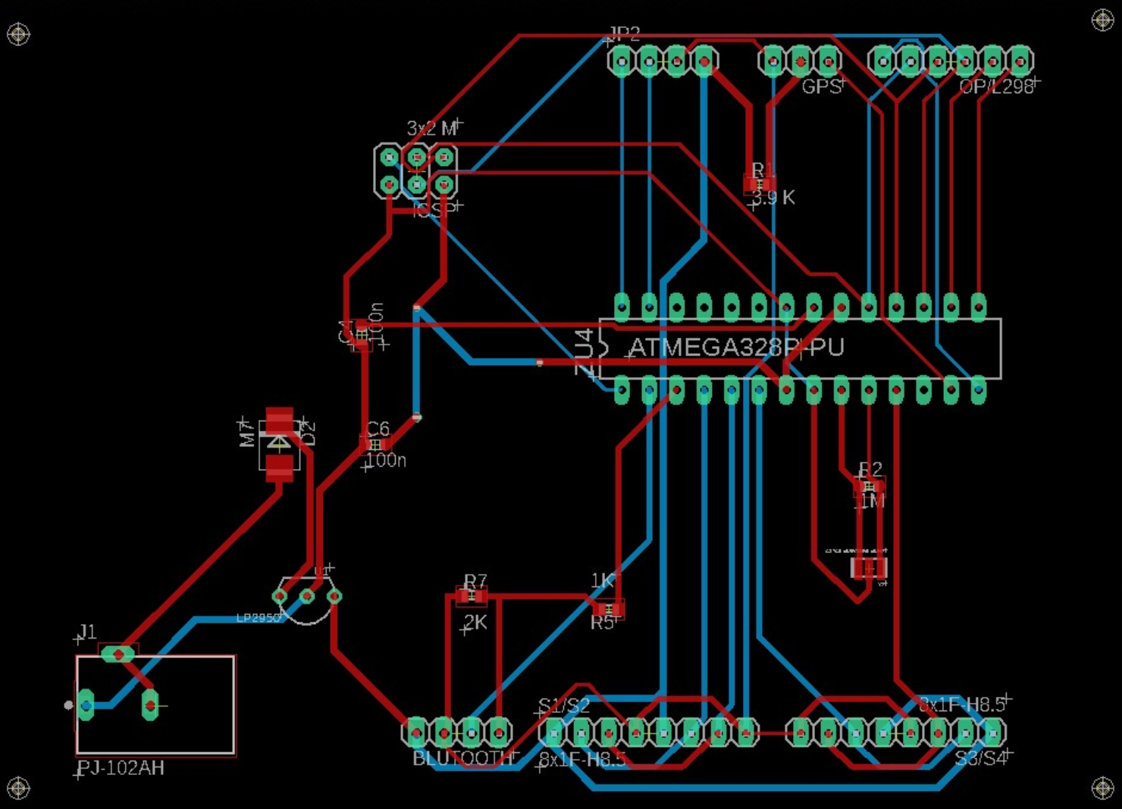
Amine Chahli

Slide 26
Wheels Comparison
Richard Garces
Brands | Nexus | Banebots | Andy Mark
Model | Clear PU | Colson | HiGrip Wheel Rev II
Diameter | 5.7 inches | 5 inches | 6 inches
Width | 1.18 inches | 1.25 inches | 1 inch
Tread material | Polyurethane | Thermoplastic rubber | Thermoplastic Polyurethane
Tread Type | Flat | Flat | Medium Tread
Load Capacity | 110 lbs | 100 lbs | 90 lbs
Price (2) | $9.04 | 6.03 | 24.00

Slide 27
Richard Garces
Wheel
AndyMark 6" HiGrip Rubber Wheel
Hub
Diameter gives clearance for clamps for the motors
High quality wheel provides durability on multiple terrains
6mm Set Screw Hub
Fits the Motor

Slide 28
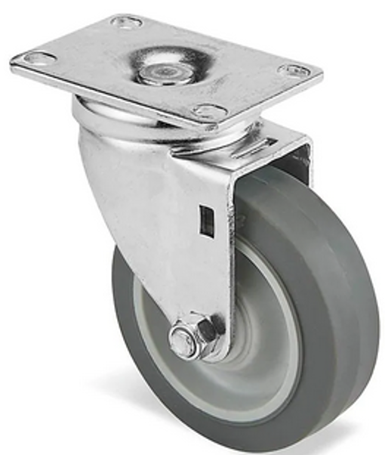
Richard Garces
Rotating/Caster Wheel
Allows for better mobility
Better for turning
Better for budget
Eliminates need for more motors
No coding needed

Slide 29
Budget
Muhammad Khan
Financial Plan
Sr # | Components | Discription/ Model | Amount | Quantity | Total Amount in | Remarks
 |  |  | in USD |  | USD
1 | Base Model | Assembly | $40.00 | 1 | $40.00 | Wood, Nut/Bolt,Glue
2 | Battery | 24 V | $34.55 | 1 | $34.55 | DC Power
3 | PCB | Printed Circuit Board | $40.00 | 2 | $80.00 | From China
4 | Voltage Regulator | DC Voltage Regulator Buck Converter | $12.90 | 1 | $12.90
5 | Tire | 4" Revolving tire | $4.99 | 1 | $4.99
6 | Tires | 6" Heavy Duty | $12.00 | 2 | $24.00 | with 2 D hubs
7 | Ultrasonic Sensor | Ultrasonic Ranging Module HC-SR04 | $1.95 | 4 | $7.80
8 | LCD Display | 1602A | $2.56 | 1 | $2.56
9 | Microcontroller | Audrino | $22.00 | 1 | $22.00 | Audrino Uno
10 | GPS Module | Navigation System | $30.00 | 1 | $30.00
11 | Resistors | Different values | 0.1 | 50 | $5.00 | Bulk
12 | Capacitors | Different values | 0.1 | 25 | $2.50
13 | Bluetooth Module | Blutooth | $7.99 | 1 | $7.99
14 | Compass Module | Direction | $15.00 | 1 | $15.00
15 | Motor | High Speed DC Motor 6-24 Volt DC | $6.95 | 2 | $13.90 | Johnson Electric
16 | Motor Driver | L298N | $5.99 | 1 | $5.99 | H-Bridge
17 | Motor Mount | Mount | $3.00 | 2 | $6.00 | Includeing nuts
18 | Battery Charger |  |  |  | $2.00
19 | Wire | 20 Feet | $8.95 | 1 | $8.95
 |  |  |  | Total | $326.13

Slide 30
Work Distribution
Muhammad Khan
Assignment | Primary | Secondary
PCB Design | Amine | Muhammad
MicroController | Richard | Amine
Battery | Amine | Muhammad
Mobile Application / GPS | Hunter | Richard
Motor / Driver | Muhammad | Amine
Assembly / Platform | Richard | Hunter
Sensor | Muhammad | Hunter
User interface | Hunter | Richard

Slide 31
Muhammad Khan

